Slide 1
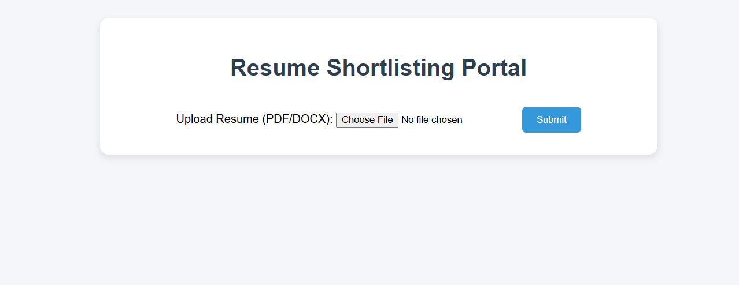
First page of RESUME_SHORTLISTER where we upload resumes as PDF/DOCS

Slide 2
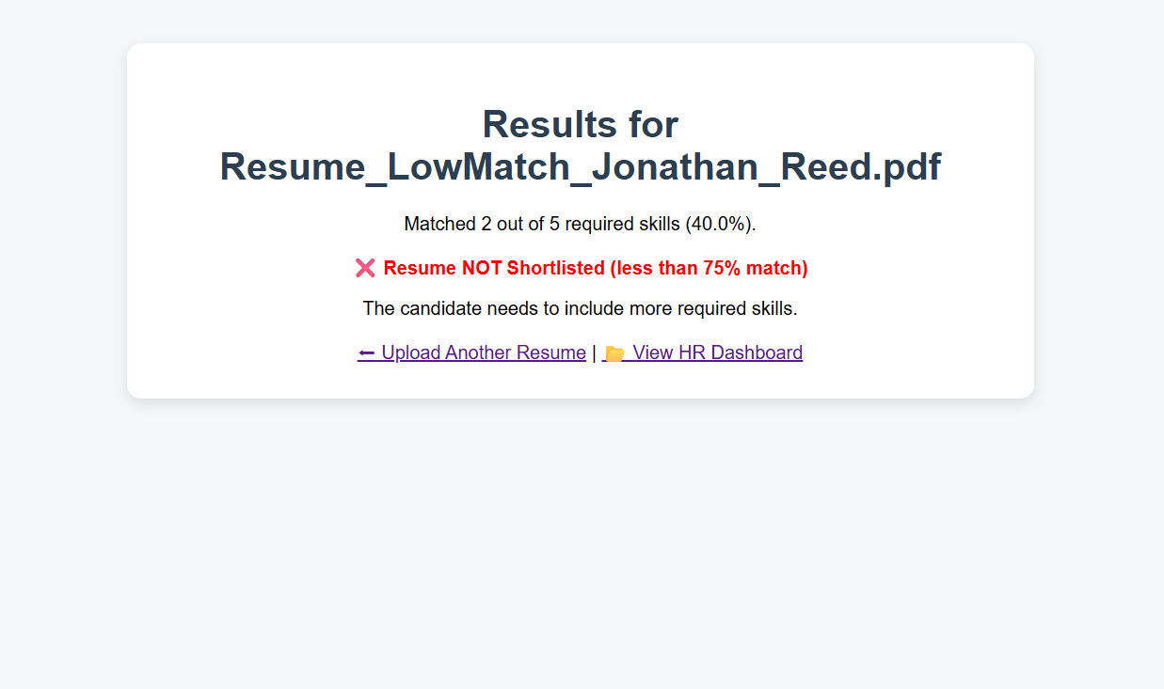
Next page after uploading a resume ,criteria can be change from backend if resume not match critera

Slide 3
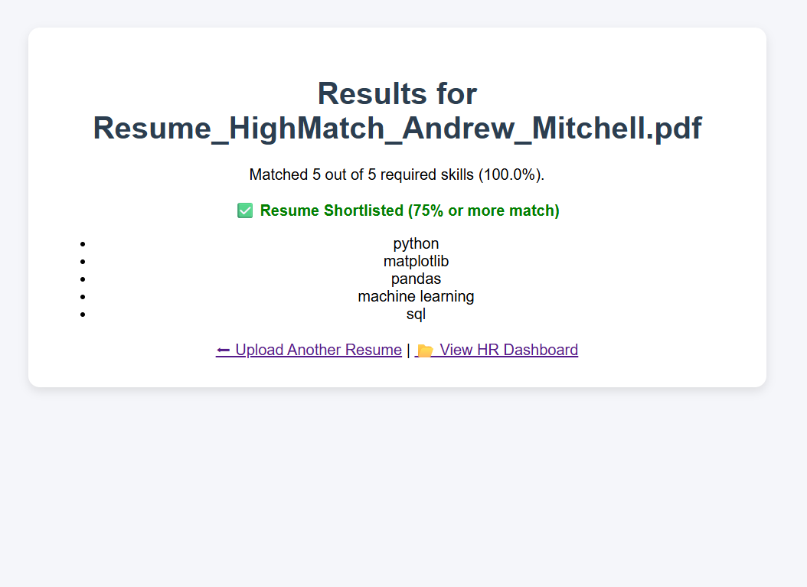
If criteria matched

Slide 4
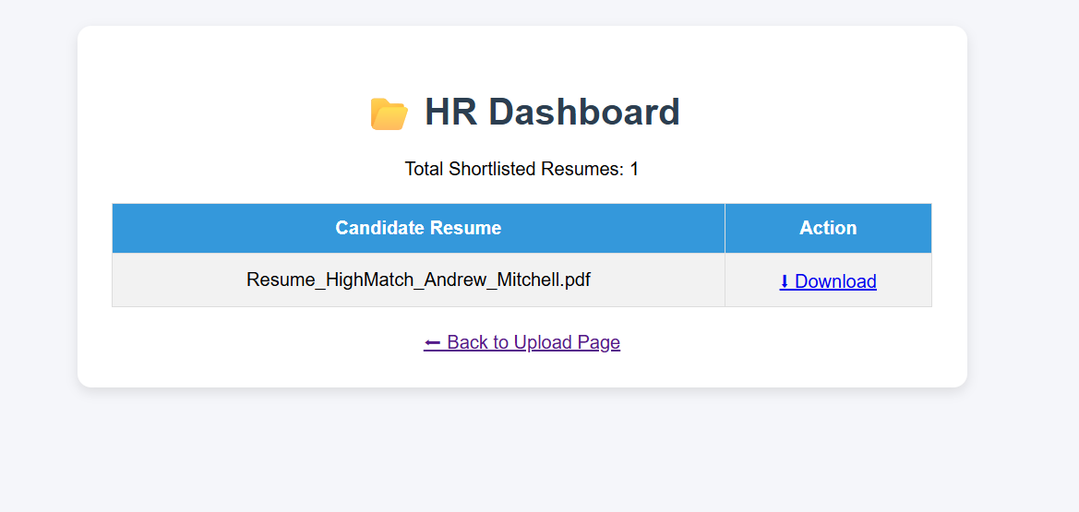
For HR view – HR dashboard only shortlisted resume will be shown

